Slide 1
The Early Middle Ages
Week-5

Slide 2
agenda
NORMAN CONQUEST
FEUDALISM
KINGSHIP
MAGNA CARTA

Slide 3
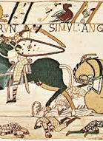
The Norman Conquest
Battle of Hasting- 1066
Herold II was against the Danes (Vikings), then William the Conqueror invaded the Britain.
Herold was killed and his army was defeated. Following this, William claimed the English throne as King William I (William the Conqueror).
The Norman Conquest is the invasion and conquest of England by William the Conqueror, Duke of Normandy, in 1066.

Slide 4
Consequences of the conquest
Feudal System: It can basically be defined as a system of distrubiting the land in exchange for service, labor, or loyalty
Language: French became the language of the ruling elite. While Old English remained the language of the common people, Norman French became the language of the court, administration, and nobility.
Social Structure: The feudal system paved the way for a rigid class structure, with kings, lords, and knights who held power and influence, whereas peasants and serfs worked the land under their control.
The gap between the wealthy elite and the common people widened.
Architecture: They started to build castles, cathedrals, and monasteries built from stone instead of wood. It caused an enduring cultural heritage.

Slide 5
FEUDALISM
Land as a reward
William gave parts of it as a reward to his captains. This meant that they held seperate small pieces of land in different parts of the country so that no noble could easily or quickly gather his fighting men to rebel. William only gave some of his nobles larger estates along the troublesome borders with Wales and Scotland. At the same time he kept enough land for himself to make sure he was much stronger than his nobles. (p.23)
William and the kings after him, thought of England as their personal property.

Slide 6
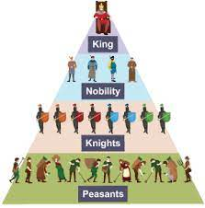
The Feudal System
The king was the absolute “owner” of land in the feudal system, and all nobles, knights, and other tenants, termed vassals, merely “held” land from the king.
They held the land in return for duty or service to a lord.
The king gave large estates to his main nobles in return for a promise to serve him in war up to 40 days. The nobles had to give him part of his produce of the land. The greater nobles gave part of their lands to lesser nobles, knights, and other freemen.
The noble kept «serfs» to work on his own land. These were not free to leave the estate, and were often little better than slaves.

Slide 7
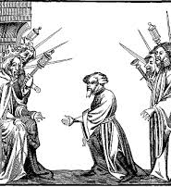
Vassal and homage
Before a lord could give land (known as a feu) to someone, he had to make that person a vassal. This was done through a formal and symbolic ceremony called a commendation ceremony, which had two main parts: homage and the oath of fealty.
During the homage part of the ceremony, the lord and the person becoming a vassal made a contract. The vassal promised to fight for the lord whenever he was asked to, while the lord promised to protect the vassal from outside threats.
So, it was like a promise exchange: the vassal promised to be loyal and fight for the lord, and in return, the lord promised to provide protection and support to the vassal. This ceremony was a crucial part of the feudal system, which governed society in medieval times.

Slide 8
Domesday Book
William summoned the compilation of the Domesday Book, a comprehensive survey of landholdings and resources.
It was useful for taxation and administration.
His men asked questions like: «How much land was there? Who owned it? How much was it worth? How many families, ploughs and sheep were there?» (p.25)

Slide 9
Conflicts for the Kingship
William I (William the Conqueror):
William II (William Rufus):
  William II, also known as William Rufus, succeeded his father William the Conqueror in 1087.
  His reign was marked by conflicts with the barons and the church.
  William II died in a hunting accident in 1100, leading to the accession of his brother, Henry I.
Henry I:
  Henry I, the youngest son of William the Conqueror, became king in 1100.
  His reign was marked by efforts to consolidate royal power and establish legal reforms.
  Henry I's reign was also characterized by conflicts with his siblings and rebellions by barons.
Stephen of Blois:
  Stephen of Blois, a grandson of William the Conqueror, seized the throne in 1135.
  His reign was marked by civil war and conflict with Empress Matilda, Henry I's daughter.
  The period of Stephen's reign is often referred to as The Anarchy due to the widespread lawlessness and disorder.
Henry II:
  Henry II, the son of Empress Matilda, became king in 1154.
  His reign was characterized by administrative reforms, including the development of the common law and the establishment of royal courts.
  Henry II also expanded the power and influence of the monarchy through his extensive land holdings and control over the Angevin Empire.

Slide 10
Magna Carta
(1215)

Slide 11
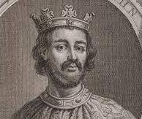
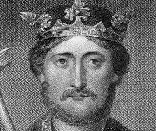
Richard Lionheart
John Lackland

Slide 12
An important symbol of political freedom
The first agreement in the history of Britain to limit the powers of the king and recognise human rights.
Originally one main aim: to make sure John did not go beyond his rights as feudal lord.
It led to the change in vassal system.

